Slide 1


Annual Payment Type Usage Analysis
Created by:
Yanyan Gatot Mulyadi
yanyangatot1059@gmail.com
https://www.linkedin.com/in/yanyan-gatot-348619177/
As a business graduate with a keen interest in data analysis, I possess a strong foundation in market research and SQL. I am adept at leveraging data to uncover valuable insights and develop impactful marketing campaigns. With a curious and innovative mindset, I constantly explore new ways to harness the power of data to drive business performance. My expertise in SQL allows me to efficiently manage and analyze large datasets, enabling data-driven decision-making. I am passionate about staying abreast of industry trends and leveraging data to achieve marketing success and deliver tangible results.

Slide 2
Overview
“Annual Payment Type Usage Analysis is the process of collecting and analyzing data about the types of payments that customers use to make purchases over the course of a year. This analysis can be used to identify trends in payment preferences, to track the performance of different payment methods, and to make decisions about which payment methods to offer to customers.”

Slide 3
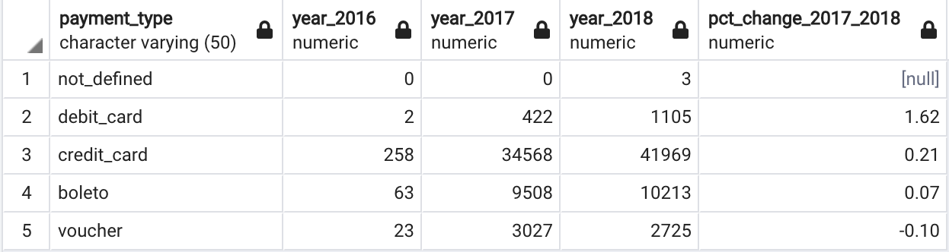
Analysis of Annual Payment Type Usage
Query selengkapnya dapat dilihat disini

Slide 4

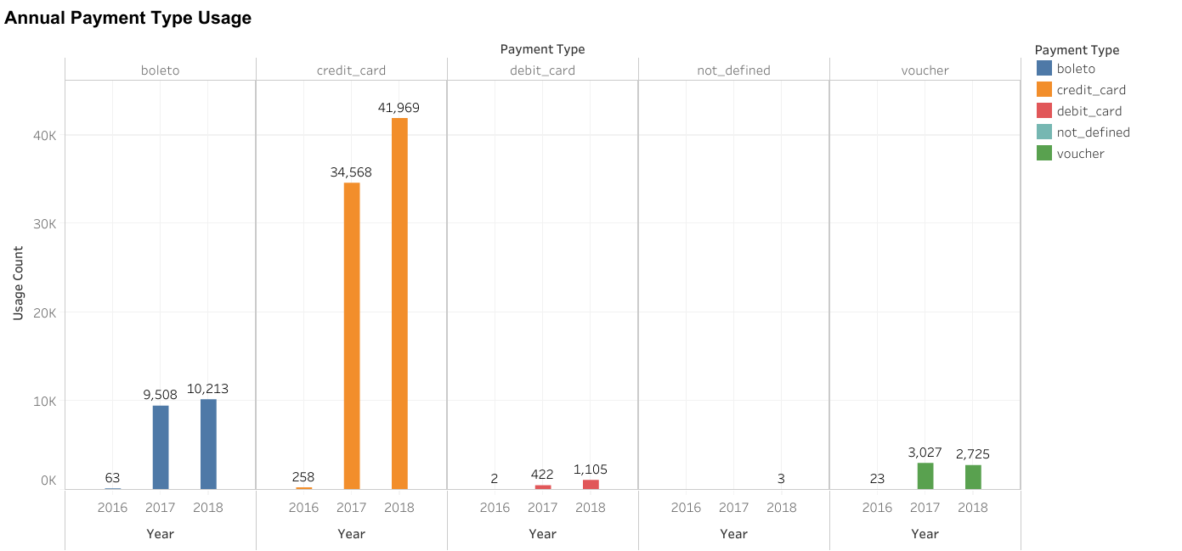
Analysis of Annual Payment Type Usage
Overall the Annual Payment Type Usage reveals interesting insights. Here are the key findings:
Credit card emerges as the most popular payment method, chosen by the majority of customers. Its usage has shown a significant increase from 2016 to 2018, indicating the growing trust and convenience associated with online transactions.
Boleto and voucher are the second and third most preferred payment methods, respectively. Unlike credit card, their usage has remained relatively stable over the years, suggesting a consistent customer preference for these options.
Debit card payments, while not as widely used as credit card, have witnessed a slight upward trend. This indicates that customers value the security and accessibility offered by debit cards, including the ability to withdraw cash from ATMs.
The "not defined" category, representing unidentified payment methods, accounts for a negligible portion of the total payments. This suggests that the majority of customers opt for the main payment methods available, namely credit card, boleto, or voucher.
Query selengkapnya dapat dilihat disini

